Slide 1
WoT Simplifies Industry Applications Sebastian Käbisch, Christian Glomb, Charif Mahmoudi, Daniel Peintner Second W3C Workshop on the Web of Things
siemens.com/corporate-technology
Internal © Siemens AG May 2019

Slide 2
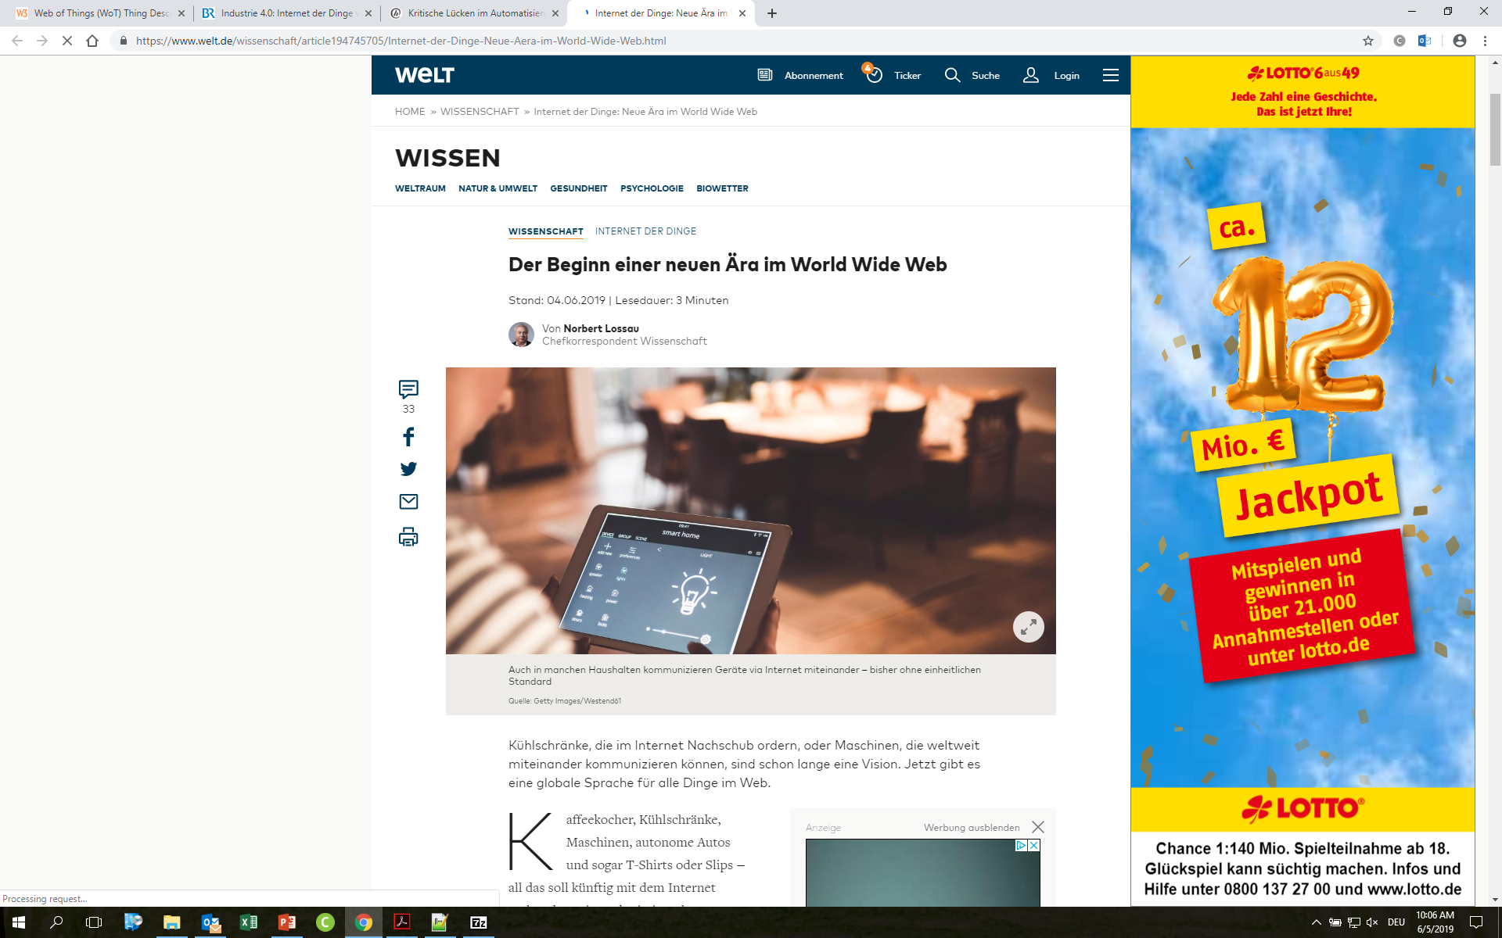
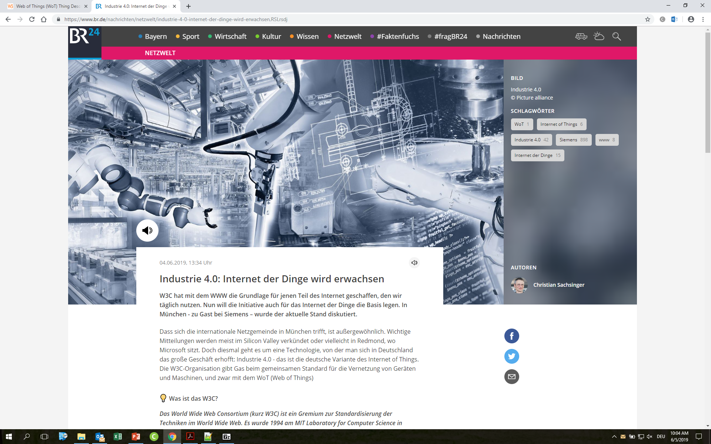
Let us spread the word about Web of Things!
External communication
Notes:
Why
Technology and market adoption
WoT has actual business relevance already now (BT using WoT, TD for Desigo CC)- Easy integration
Future integrated SI portfolio will be supported by easy integration + 3rd party integration
Standard for WoT expected in Summer 2019 – expected market adoption
Siemens
Multi Domain integration (cross BU)
Siemens Expert / Leader in Standardization
Leverage BT pilot
CeM
Reasonable Invest
PoC until Summer / big event W3C + Showcase
Cross BU coordination + Business Development

Slide 3
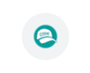
Let us spread the word about Web of Things!
Internal communication
Whenever possible, along with conventional approaches, our team should try out a WoT solution and share the code in our internal repository
Come up with use cases
Implement proof of concept demonstrators
Discuss with business units about business relevance and identify the unique WoT selling point
WoT
Integration
Notes:
Why
Technology and market adoption
WoT has actual business relevance already now (BT using WoT, TD for Desigo CC)- Easy integration
Future integrated SI portfolio will be supported by easy integration + 3rd party integration
Standard for WoT expected in Summer 2019 – expected market adoption
Siemens
Multi Domain integration (cross BU)
Siemens Expert / Leader in Standardization
Leverage BT pilot
CeM
Reasonable Invest
PoC until Summer / big event W3C + Showcase
Cross BU coordination + Business Development

Slide 4
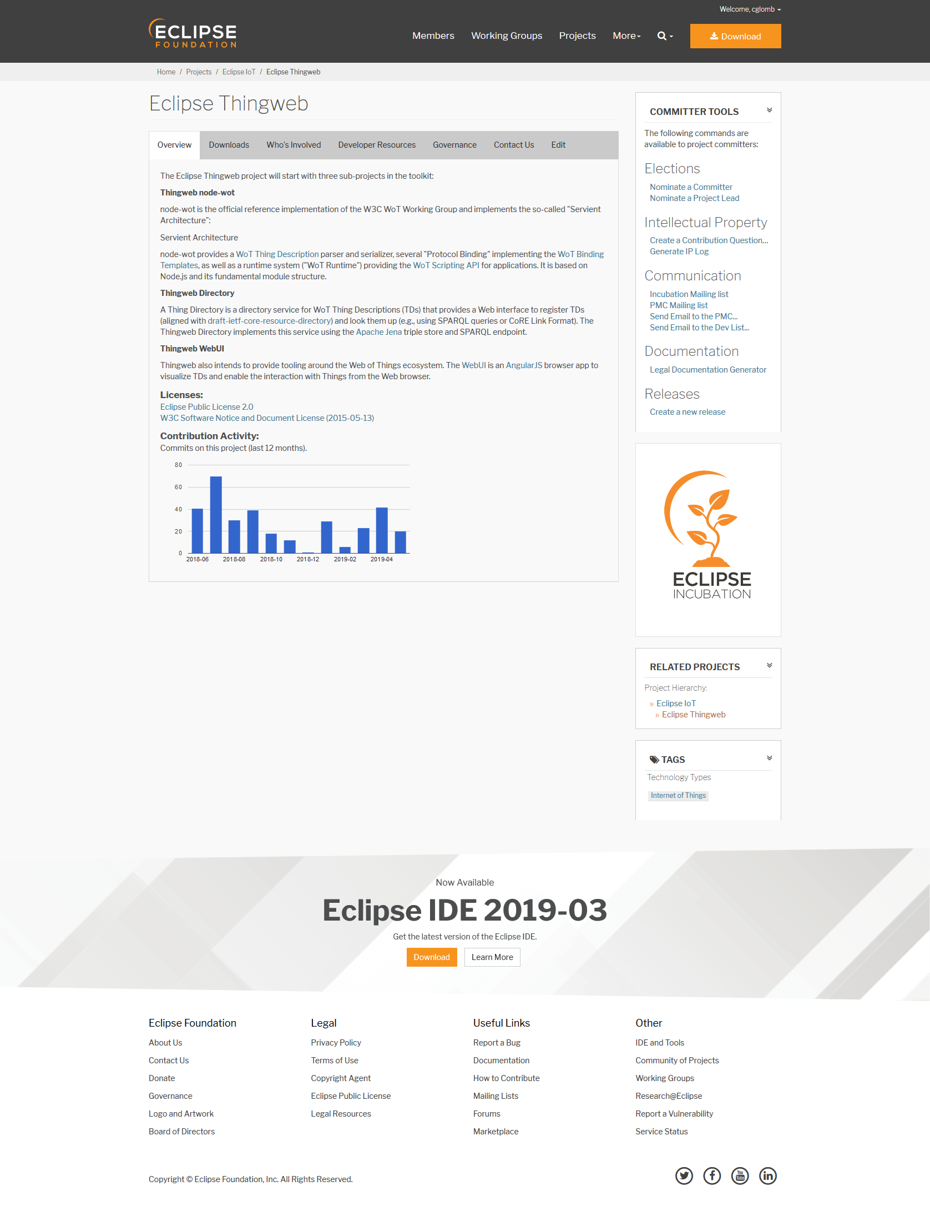

Slide 5
Let us find a way to not just interchange Thing Descriptions but also (parts of) application logic!
Scripting API
Simplified API
https://github.com/w3c/wot-scripting-api/issues/64
Browser API
Enable market places / application stores
Notes:
Why
Technology and market adoption
WoT has actual business relevance already now (BT using WoT, TD for Desigo CC)- Easy integration
Future integrated SI portfolio will be supported by easy integration + 3rd party integration
Standard for WoT expected in Summer 2019 – expected market adoption
Siemens
Multi Domain integration (cross BU)
Siemens Expert / Leader in Standardization
Leverage BT pilot
CeM
Reasonable Invest
PoC until Summer / big event W3C + Showcase
Cross BU coordination + Business Development

Slide 6



Let us remember that WoT is not the n^{th} + 1 IoT protocol but rather the glue for existing and new protocols!
Binding templates
{ "@context": […], "@type": "Thing", "id": "urn:dev:ops:13473-temp-12", “title": "Temperature", "security": { "scheme": "oauth2" }, … "properties" : { "value": { "type": "number", "minimum": "-40.2", "maximum": "48.4", "unit": "Celsius", "forms": [{ "href": "opc.tcp://192.168.0.1:4840…", "contentType": "application/octet-stream“, “opcua:methodName": “READ"
}]}}}
{ "@context": […], "@type": "Thing", "id": "urn:dev:ops:53473-lamp-12", "name": "Lamp", "security": { "scheme": "basic" }, … "properties" : { "status": { "forms": [{ "href": “bacnet://192.168.0.20/…", “bacnet:methodName": “WRITE"
{ "@context": […], "@type": "Thing", "id": "urn:dev:ops:42473-engine-12", "name": "Engine", "security": { "scheme": “basic" }, … "properties" : { "status": { "forms": [{ "href": “modbus+tcp://192.168.0.98:502/….", “modbus:methodName": “READ"

Slide 7
Let us take Eventing to the next level!
Interaction affordance: Events
Not just change of value (which can be observable property)
Complex eventing, temporary things
Alarms
Time series (?)
Guidlines for Web
WebSub
Event Source
…
Notes:
Why
Technology and market adoption
WoT has actual business relevance already now (BT using WoT, TD for Desigo CC)- Easy integration
Future integrated SI portfolio will be supported by easy integration + 3rd party integration
Standard for WoT expected in Summer 2019 – expected market adoption
Siemens
Multi Domain integration (cross BU)
Siemens Expert / Leader in Standardization
Leverage BT pilot
CeM
Reasonable Invest
PoC until Summer / big event W3C + Showcase
Cross BU coordination + Business Development

Slide 8
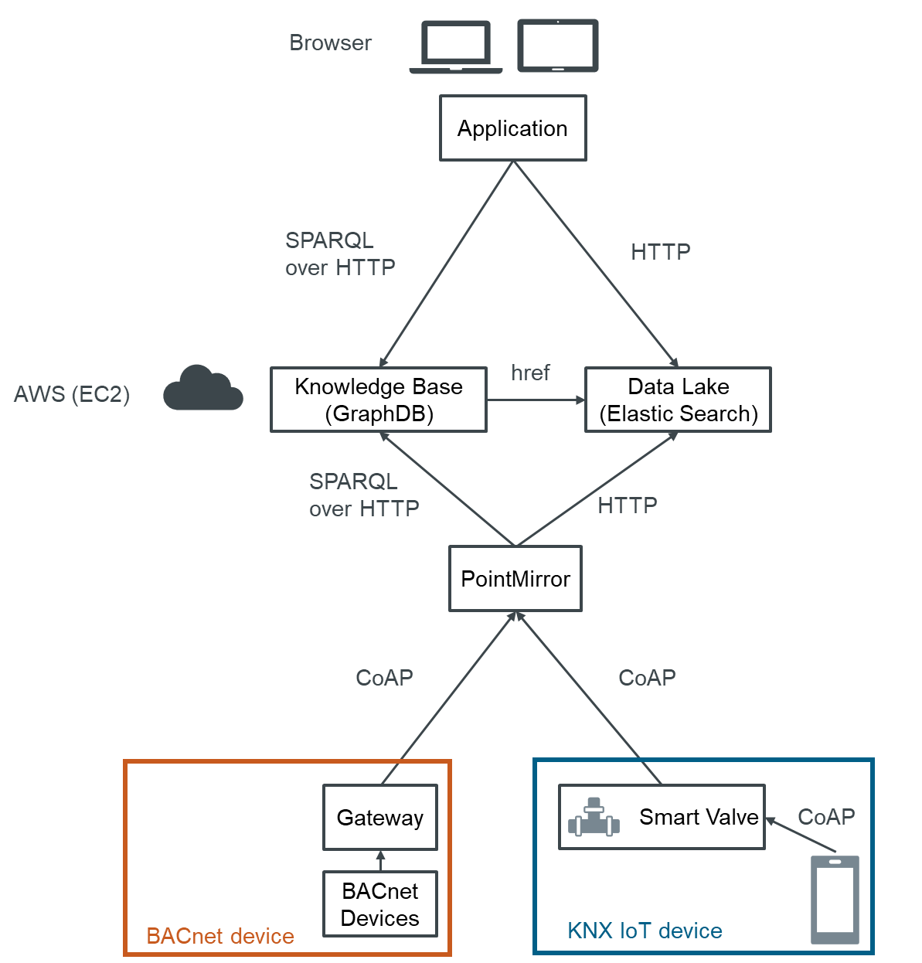
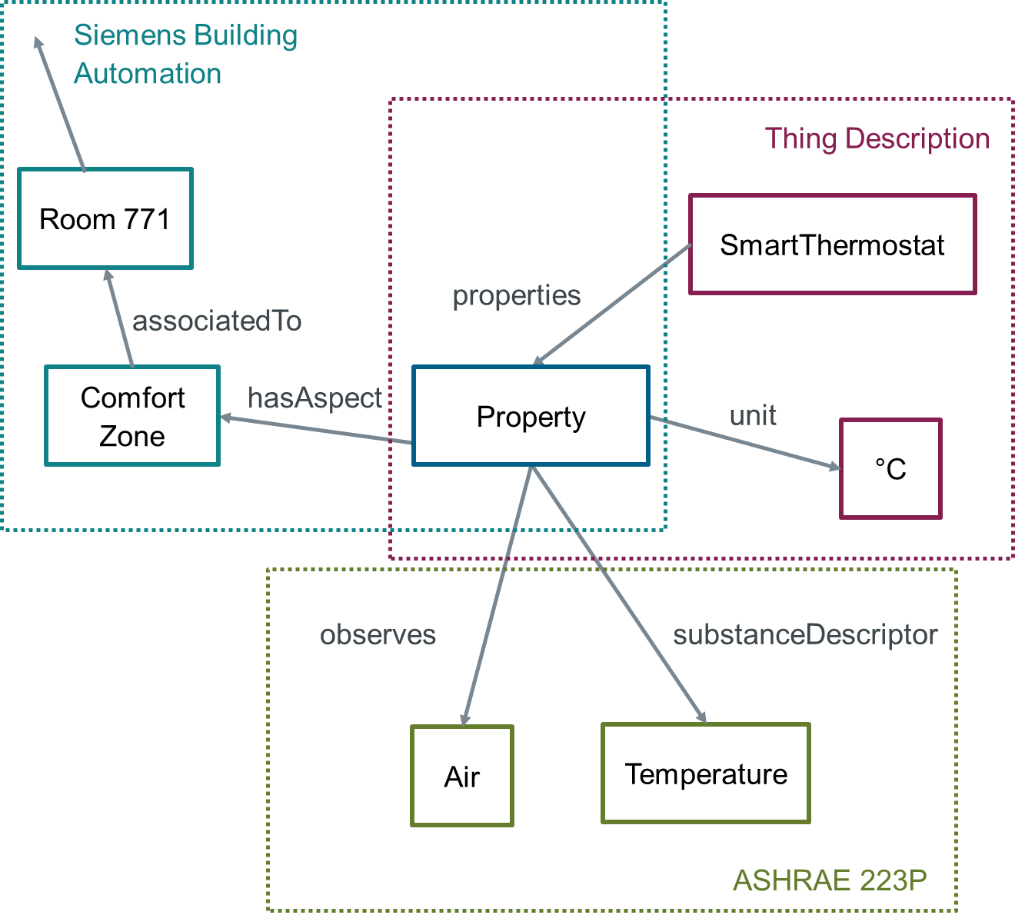
Building Products is and will be using Thing Descriptions.
Building monitoring application based on WoT
Enriching Thing Descriptions with domain specific data
Notes:
Why
Technology and market adoption
WoT has actual business relevance already now (BT using WoT, TD for Desigo CC)- Easy integration
Future integrated SI portfolio will be supported by easy integration + 3rd party integration
Standard for WoT expected in Summer 2019 – expected market adoption
Siemens
Multi Domain integration (cross BU)
Siemens Expert / Leader in Standardization
Leverage BT pilot
CeM
Reasonable Invest
PoC until Summer / big event W3C + Showcase
Cross BU coordination + Business Development

Slide 9
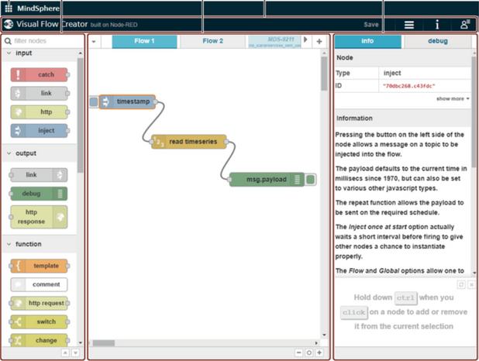
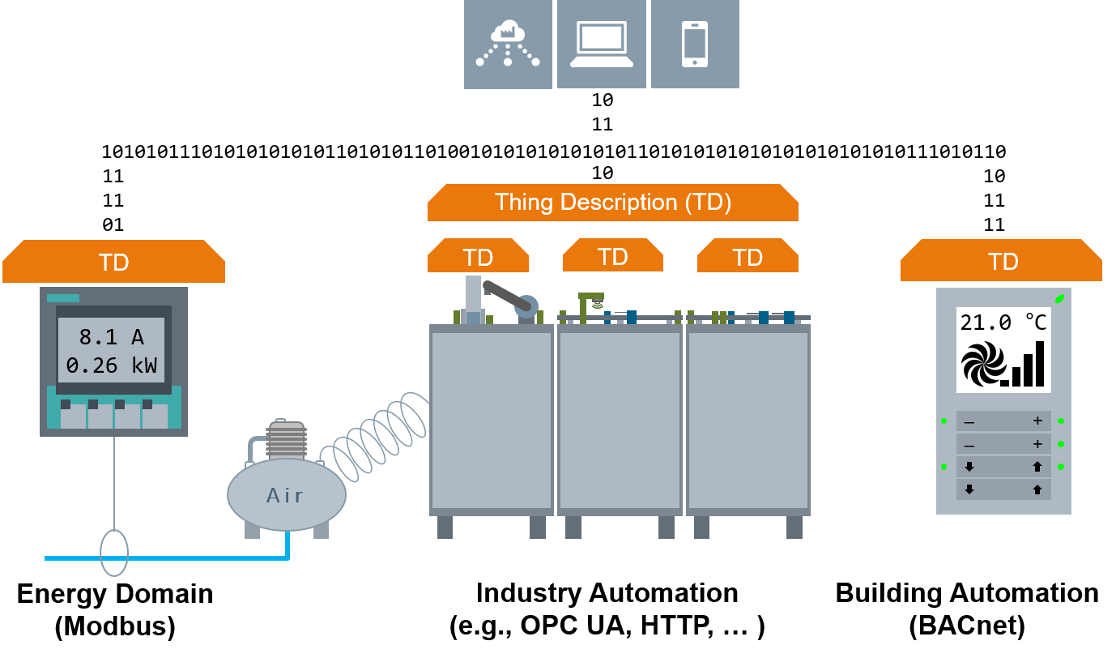
Digital Industries might leverage WoT benefits.
Simplified domain integration
Ease engineering on Mindsphere
Notes:
Why
Technology and market adoption
WoT has actual business relevance already now (BT using WoT, TD for Desigo CC)- Easy integration
Future integrated SI portfolio will be supported by easy integration + 3rd party integration
Standard for WoT expected in Summer 2019 – expected market adoption
Siemens
Multi Domain integration (cross BU)
Siemens Expert / Leader in Standardization
Leverage BT pilot
CeM
Reasonable Invest
PoC until Summer / big event W3C + Showcase
Cross BU coordination + Business Development

Slide 10
Thank you for your attention!
Dr. Sebastian Käbisch Christian Glomb
Dr. Charif Mahmoudi
Dr. Daniel Peintner
Visit thingweb.io

